Slide 1





GRT-Arm
Gesture Replication and Translation for Robotic Arm
Team Members
Mohamed Omar
Hamza Ehab
Boshra Akram
Farida Abdelbaky
Mohamed Tarek

Slide 2


Overview
This project integrates computer vision, machine learning, and robotics to create a system that combines real-time image processing, gesture recognition, serial communication, and precise robotic control to achieve seamless translation of visual inputs into physical outputs.

Slide 3

Project Flow
Captures hand gestures using a webcam.
Processes and classifies gestures into corresponding letters (e.g., American Sign Language alphabet).
Sends the classified letter to an Arduino via serial communication.
Controls a robotic arm to mimic the gesture corresponding to the letter.
The letter is displayed on an LCD

Slide 4



components used
7 Servo Motors
Arduino UNO
ESP8266
bread boards
3 batteries (3.7v each)
Wires
Buck Adapter
LCD I2C

Slide 5

Computer Vision libraries :
OpenCV (cv2)
MediaPipe
is an Open-source computer vision library used here for capturing video frames, image processing and displaying results.
Is a framework, provides pre-built solutions for tasks like hand tracking, face detection, pose estimation, object detection, and more.

Slide 6

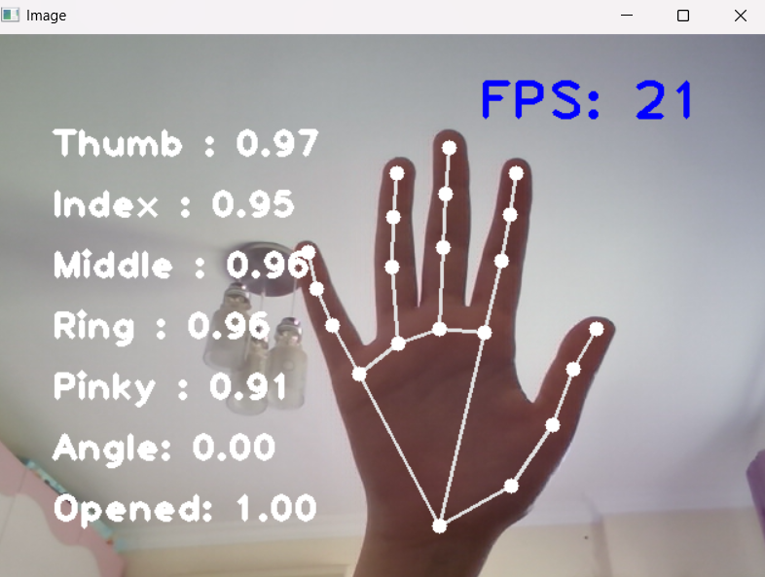

Slide 7
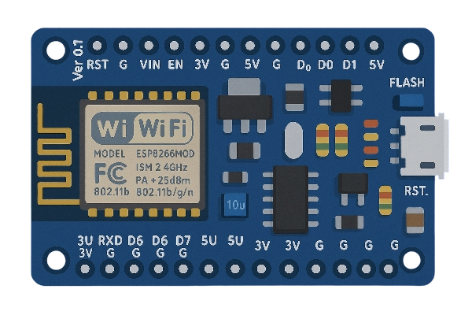
ESP8266
The ESP uses WebSocket Protocol to receive data from another device wirelessly (e.g., a cell phone or computer) over the network and sends it to the Arduino.

Slide 8
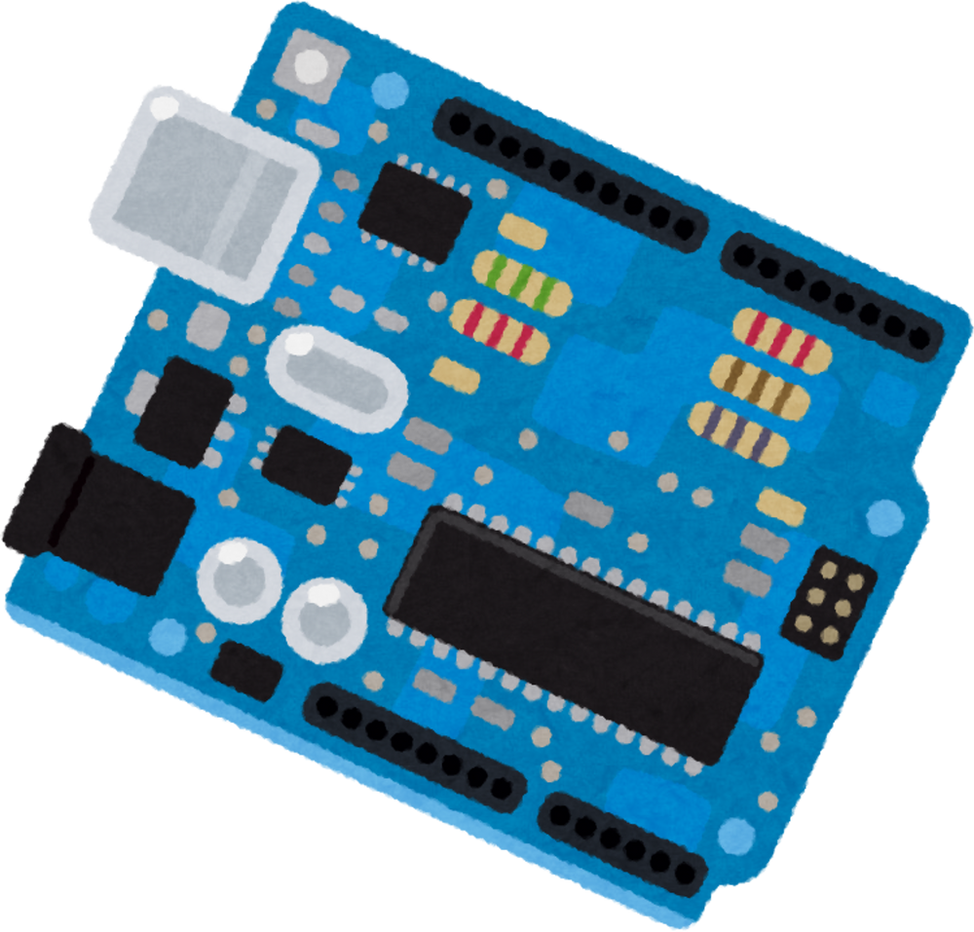
Arduino Uno
The Arduino receives input data from the ESP module via Serial
It processes the received data to translate the gesture to the matching letter.
Based on the input, it sends precise control signals to the corresponding servo motor in the Robotic Arm.
Each servo controls a specific finger of the robot arm, enabling coordinated movement.

Slide 9
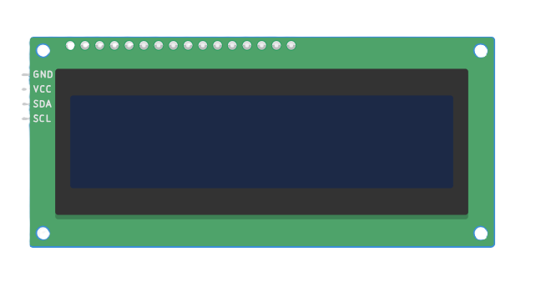
LCD I2C
The system incorporates an LCD I2C module to provide real-time feedback and enhance user interaction. This 16x2 LCD, interfaced via the I2C protocol, displays the recognized letter from the gesture recognition process, as well as the robotic arm’s status, such as "Gesture: A" .
This display offers a clear, immediate visual confirmation of the system’s operation, improving usability and debugging during gesture translation.
RoboTech

Slide 10
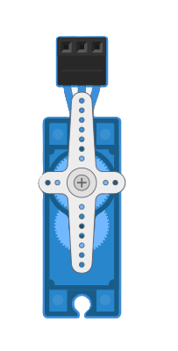
Servo Motors
In the robotic arm, servo motors are pivotal for mimicking hand gestures, with each servo dedicated to controlling one finger. Each motor precisely adjusts the angle of its corresponding finger, enabling the arm to replicate specific letter gestures

Slide 11
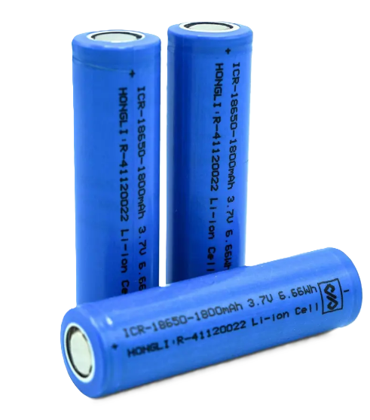
Batteries and Adapters
The robotic arm’s power system is driven by 3.7V batteries and a buck adapter to ensure reliable operation. These 3.7V batteries supply power to the servo motors and Arduino, providing the necessary energy for consistent gesture execution.

Slide 12
Thank You ^^

